Slide 1
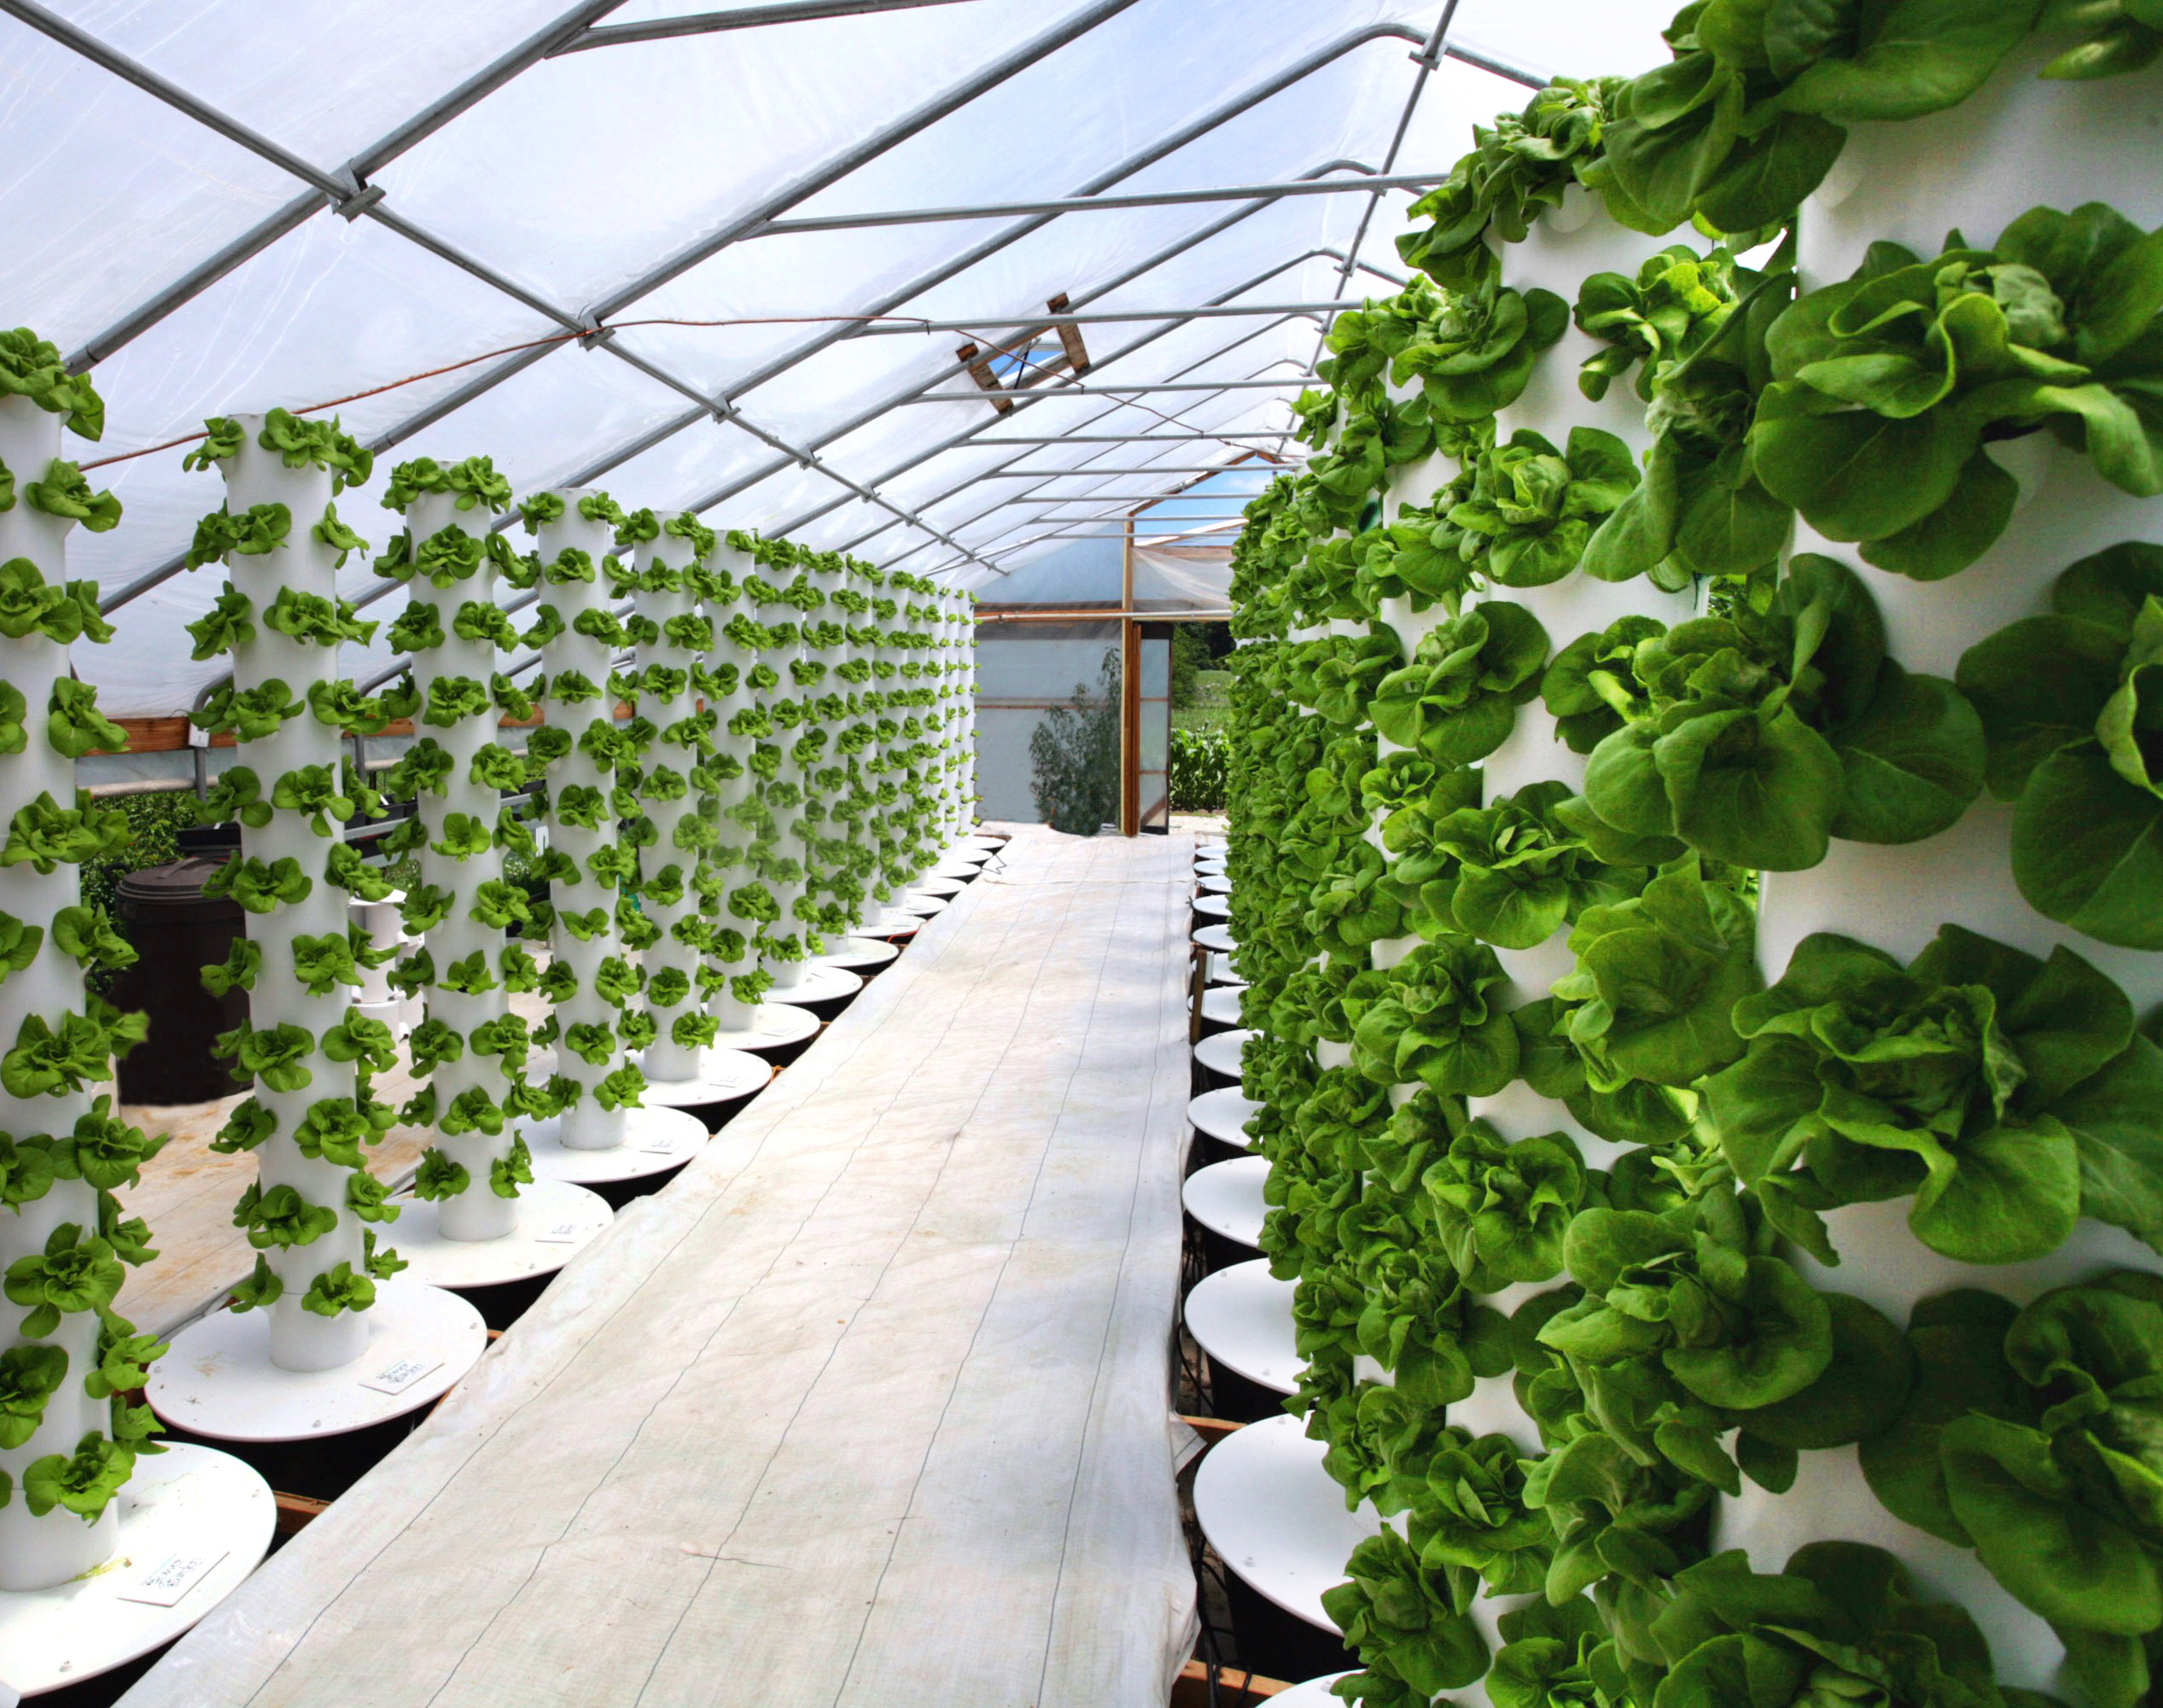
Vertical Farming – Food Sustainability

Slide 2
Greenhouse Urban Cle
Start up costs depend on size, access to sunlight, energy source
Water circulation
Cooling
LEDs
Equipment
Labor costs
One estimation for brand new facility ~$100 million
The Plant in Chicago: $1.7 million in grant
4-storey reclaimed building

Slide 3
Opportunity and Efficiency
Vertical Farms operating typically for-profit
Recommend government subsidy to encourage vertical farming endeavors
Like grant in Chicago, The Plant
Anticipates rapid urbanization
Double output per square foot
Cleaning cities

Slide 4
Availability of Buildings for Upconversion
Opportunities. Photo Rep.

Slide 5
Options!
Vertical farming options

Slide 6
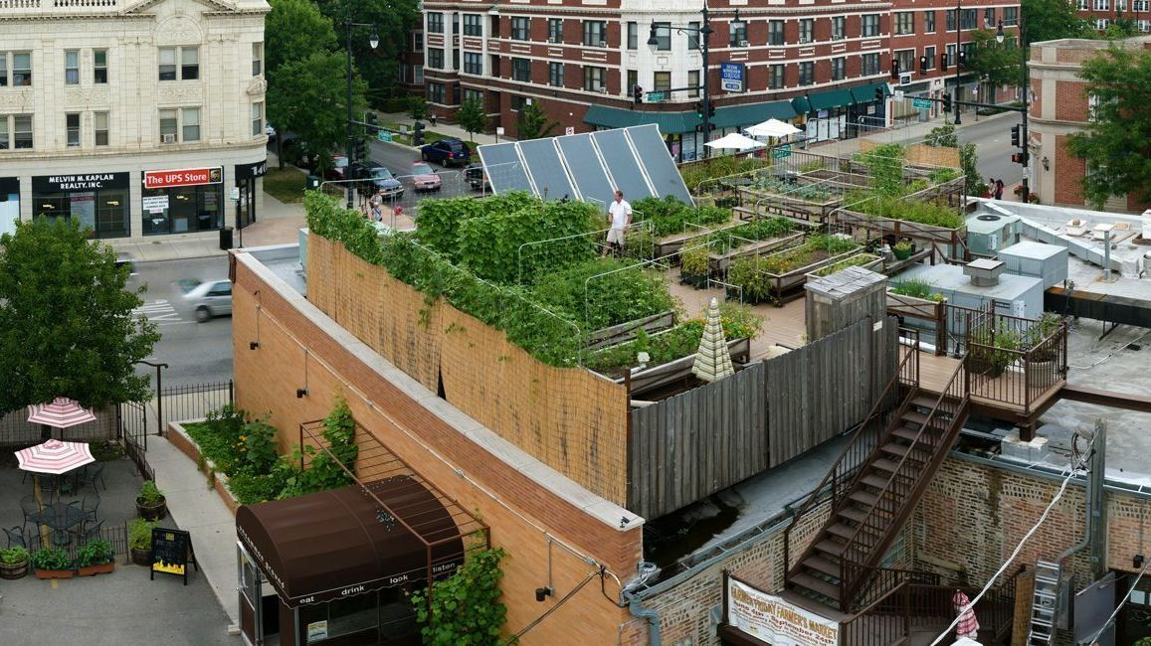

Slide 7
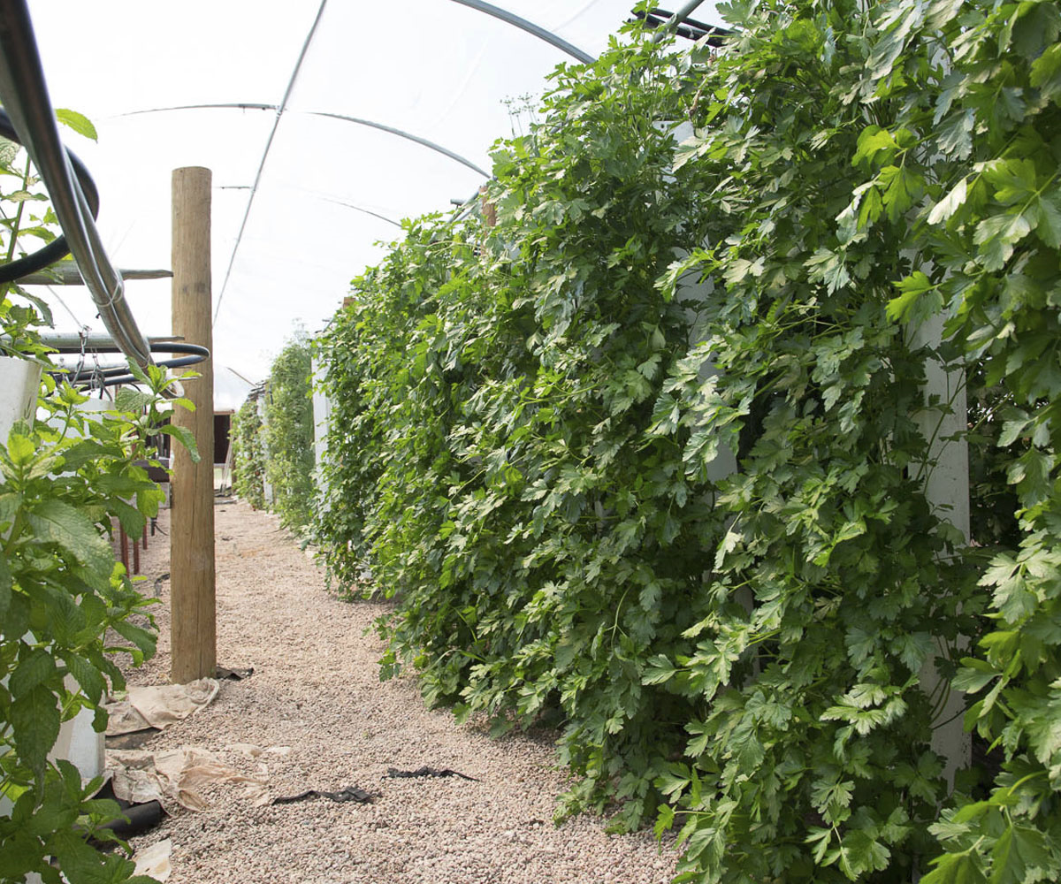

Slide 8
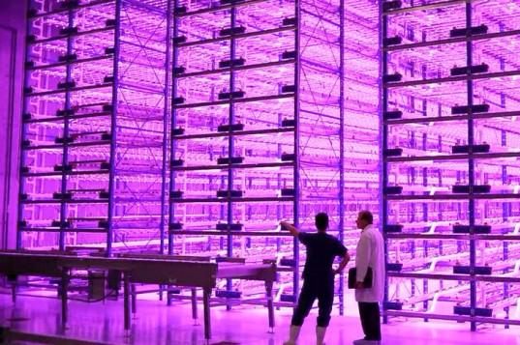

Slide 9
